Slide 1
Engaging Transitioning Youth
Presented by:
Shari Zouhairi, LCSW-C, Supervisor
Myrtle Barrie-Jemmott, LMSW, IL Coordinator

Slide 2
Today’s
Agenda
Who are Transitioning Youth?
Transitioning Youth Statistics
Ready by 21 Policy Manual
Core Values of Providing Services
Ready by 21 Benchmarks
  Education & Employment
  Well-Being & Civic Engagement
  Permanent & Supportive Connections
  Financial Empowerment
  Safe & Stable Housing
Additional Resources Available to Youth
Challenges that Arise As Youth Age Out of Care
Q&A

Slide 3
Who Are Transitioning Youth?
Youth between the ages of 14 and 21.
Have a permanency Plan of APPLA (Another Planned Permanent Living Arrangement).
The overarching goal for Maryland’s Transitional Youth Services is to transition youth from foster care to successful adulthood.
Successful adulthood is defined as when a youth exits the foster care system with the transitional skills to become self-sufficient as age and developmentally appropriate for the youth.

Slide 4
Youth Demographics
(Point in Time 9/30/23)

Slide 5
Permanency Plans (Point in Time 9/30/23)
OOH Youth Ages 16 - 21: Permanency Plans
APPLA Permanency Plan by Age

Slide 6
Placement Types (Point in Time 9/30/23)

Slide 7
Exiting OOH Care

Slide 8
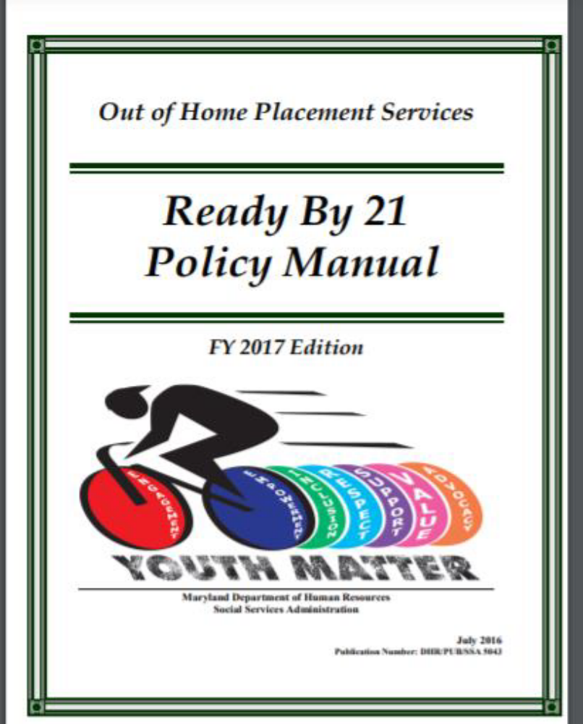
Transitioning Youth Services are guided by the
“Ready by 21” manual, published by SSA

Slide 9
Core Values as defined by the “Ready by 21” manual
Respect
Youth and staff must treat each other with respect. Mutual cooperation is encouraged to ensure that youth and staff are able to work together in a respectful, courteous manner to address the needs and goals of the youth.
Value
Youth voice and perspective are important. All efforts and accomplishments are celebrated. The thoughts and ideas of youth help facilitate improved services and resources to meet individual needs and goals.
Inclusion
Youth have a right to be included in all decisions about their future. Youth participation is encouraged in all planning and decision-making processes deemed developmentally appropriate.
Advocacy
Youth will develop the skills, through education and opportunities, to give voice to their opinions, advocate for themselves, and become leaders in their communities.
Empowerment
Youth matter in Maryland. Their roles as experts in their lives is understood and valued. By keeping youth informed, building on their strengths, and providing the space and responsibility to make their own decisions, youth are encouraged to reach their full potential
Support
Youth are assisted in creating a network of support, made up of caring individuals who will provide lifelong connections.

Slide 10
“Ready by 21” Benchmarks
Education and Employment
Well-Being and Civic Engagement
Permanent and Supportive Connections
Financial Empowerment
Safe and Stable Housing

Slide 11
Education & Employment
End Goal: For foster youth to be able to navigate secondary and post-secondary educational institutions. understand how to access job search resources, complete employment applications, create a resume, manage interviews, and maintain jobs.

Slide 12
Secondary Education
Post Secondary Education
Social workers collaborate with school systems, educators, Pupil Personnel Workers (PPW), and guidance counselors to support youth as they move through their educational career in pursuit of either a high school diploma, certificate or GED.
The TYS unit works specifically with high school seniors to prepare them for college, taking them on college tours and helping with applications and the FAFSA, etc.
Examples of Post Secondary Education include community college, 4-year universities, vocational/ technical or certificate programs
Funding is provided through the MD Tuition Waiver, the Educational Training Voucher (ETV), Pell Grants and scholarships, and/or Department funding

Slide 13
Employment
Youth shall obtain responsible work experience opportunities within their chosen career path
The Department works with youth to identify opportunities for Internships, volunteer experience, paid employment, etc.
Youth shall be assisted in developing a resume, applying for jobs and obtaining work permits as needed
Youth shall be supported in acquiring professional attributes that will help them maintain employment
Resources that our youth can be referred to include:
  Latin American Youth Center (LAYC)/ Maryland Multicultural Youth Center (MMYC)
  Equus Workforce Solutions
  Future Link
  MoCo YES!
  Job Corps

Slide 14
Well-Being & Civic Engagement
End Goal: for youth to have a specific plan for the coordination of their physical and behavioral health care needs, understand their legal rights, know how to vote in local, state, and federal elections, and know how to self-advocate when needed.

Slide 15
Well-Being & Civic Engagement
Youth shall understand the following:
  Youth has a specific plan for the coordination of their physical/behavioral health care needs.
  Youth knows how to obtain a copy of their Medical Assistance card and how to obtain Medicaid.
  Youth understands their medical histories and how to get their immunization records.
  Youth demonstrates safe food prep and knows basic nutrition and healthy diets.
  Youth understands safe dating/sex practices, healthy relationships, harassment/assault and can access resources, including birth control.
  Youth understands the risks of alcohol, tobacco, opioids, and illegal substances, and where to go for help.
  Youth understands of the need for sleep, exercise, and a healthy and balanced diet, and can practice self-care.
  Youth can register to vote, obtain candidate information, and how to vote in local, state, and federal elections.
  Youth will understand the Jury duty process.
  Youth has the skills to self-advocate.
  Youth understands about their legal rights and how to obtain legal representation.
  Youth knows about human trafficking and how to protect themselves.
  Youth can obtain help from law enforcement & medical/behavioral personnel, if they
  are a victim.

Slide 16
Permanent & Supportive Connections
End Goal: for the youth to have an established support network

Slide 17
Permanent & Supportive Connections
Assist youth in understanding how to develop positive and safe relationships; identifying appropriate committed adult supports; and understanding the importance of developing lifelong connections
These are some examples of how the Department helps in this process:
  Facilitating visitation and ongoing contact between youth and their family, friends, and other significant relationships
  Family Team Decision Meetings
  Youth Transition Plan Meetings
  Mentoring programs can also provide support
  Family Finding and Absent Parent Locator services
  Court Appointed Special Advocates

Slide 18
Financial Empowerment
End Goal: for the youth to be able to save money and afford an age-appropriate lifestyle

Slide 19
Financial Empowerment
Youth shall understand basic financial tools and responsibilities
  Budget creation and management
  Bank accounts – youth should have both a checking and savings account by the time they exit care
  Credit Report
  Completion of the Keys Financial Training Class through state of Maryland
  Youth shall have basic knowledge of entitlement programs such as Medical Assistance and SNAP (food stamps)
  Youth will be assisted with obtaining an original birth certificate and social security card
  Youth shall be assisted with obtaining a MD state ID, Learner’s Permit and/or Driver’s License

Slide 20
Safe & Stable Housing
End Goal: for the youth to have permanent housing after case closure

Slide 21
Safe & Stable Housing
Housing While In-Care
Housing Post Case Closure
Transitioning youth reside in a variety of placements including:
  Kinship homes
  Foster homes
  Group home
  Independent Living Programs (ILP)
  Semi-Independent Living Arrangements (SILA)
Youth can access a variety of housing voucher programs which include:
  Youth Bridge Initiative
  Foster Youth Independence
  Residential Rehabilitation Programs
  Transitional Housing Programs
  Private lease or rentals

Slide 22
Additional Resources Available to Youth

Slide 23
Additional Resources Available to Youth
Transitioning Youth Learning Collaborative
Montgomery County Youth Advisory Board
Independent Living Coordinator for Montgomery County
Life Skills classes and Keys Financial Literacy classes
Liaison for the State of Maryland
COG Youth Advisory Board
Interagency Commission of Homeless Youth
Aftercare Services

Slide 24
Challenges That Arise When Youth Age Out of Care

Slide 25
As youth move towards emancipation, some will experience challenges, including:
Identifying permanent housing resources
Limited services available to undocumented youth
Lack of significant adult connection/support
Limited employment opportunities
Lack of income support and safety net
Notes:
Keeping Up: A smartphone application

Slide 26
Q&A

